Slide 1
CONVO-LYSER
MOBILE APPLICATION DEVELOPMENT
(IT7013)
ADITI BASKAR (2018506006)
AMRUTHAVARSHINI R (2018506015)
GOWRI S (2018506034)
KIRUPALINI S (2018506054)
SWETHA S (2018506134)

Slide 2
AGENDA
Overview
Technology Stack
KivyMD
Workflow
Modules
Output
Results

Slide 3
OVERVIEW
Convo-Lyser is a conversation analyser mobile application which extracts different features from chats like emotions, sentiments, aspects, semantic relationships.
The main aim of this app is to provide a method to detect child grooming characteristics and alert the user and report the authorities in case of such occurrences.
Additionally, a report portal facility and statistics page containing news articles pertaining to grooming is also available.

Slide 4
TECHNOLOGY STACK
Python 3.8 (Pycharm IDE)
Kivy MD
Joblib
Sklearn
NLTK
SMTP
Pandas
CSV
LIWC
Gensim
IBM Watson

Slide 5

KivyMD
KivyMD is a collection of Material Design compliant widgets for use with Kivy, is an open source, cross-platform Python framework for the development of applications that makes use of innovative, multi-touch user interfaces.
Kivy MD is based on Kivy and while some design aspects are much easier to implement.
Currently it is in beta status, so things are changing all the time and doesn’t assure any kind of API stability. However it is safe to vendor now and make use of what's currently available.

Slide 6
KivyMD Packages
from kivymd.app import MDApp from kivy.lang import Builder from kivy.core.window import Window from kivymd.theming import ThemableBehavior from kivymd.uix.filemanager import MDFileManager from kivymd.uix.boxlayout import BoxLayout from kivymd.toast import toast from kivy.uix.screenmanager import ScreenManager from kivymd.uix.button import MDRectangleFlatButton, MDFlatButton from kivymd.uix.dialog import MDDialog from kivymd.uix.list import MDList from kivymd.uix.list import OneLineListItem, TwoLineListItem, ThreeLineListItem from kivymd.uix.taptargetview import MDTapTargetView

Slide 7
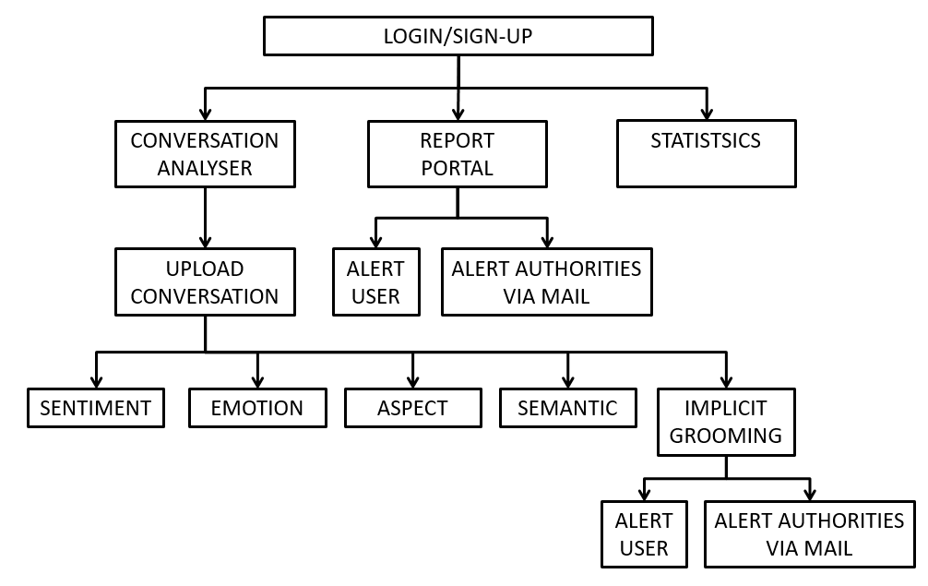
WORKFLOW

Slide 8

IBM WATSON
IBM Watson tone analyser and Natural Language Understanding packages are used to analyse the unstructured data for polarity, emotions and aspects.
Conversation given into Watson NLU.
It analyses the original text with the Watson Studio which, builds, runs and manages AI models, and optimize decisions. Overall, it helps data scientists and analysts prepare data and build models.
It is then given to the Classification module, wherein for any given input it gives various classifications like Sentiment, Emotion, Keywords, Entities, Categories, Concept, Syntax, Semantic Roles.

Slide 9
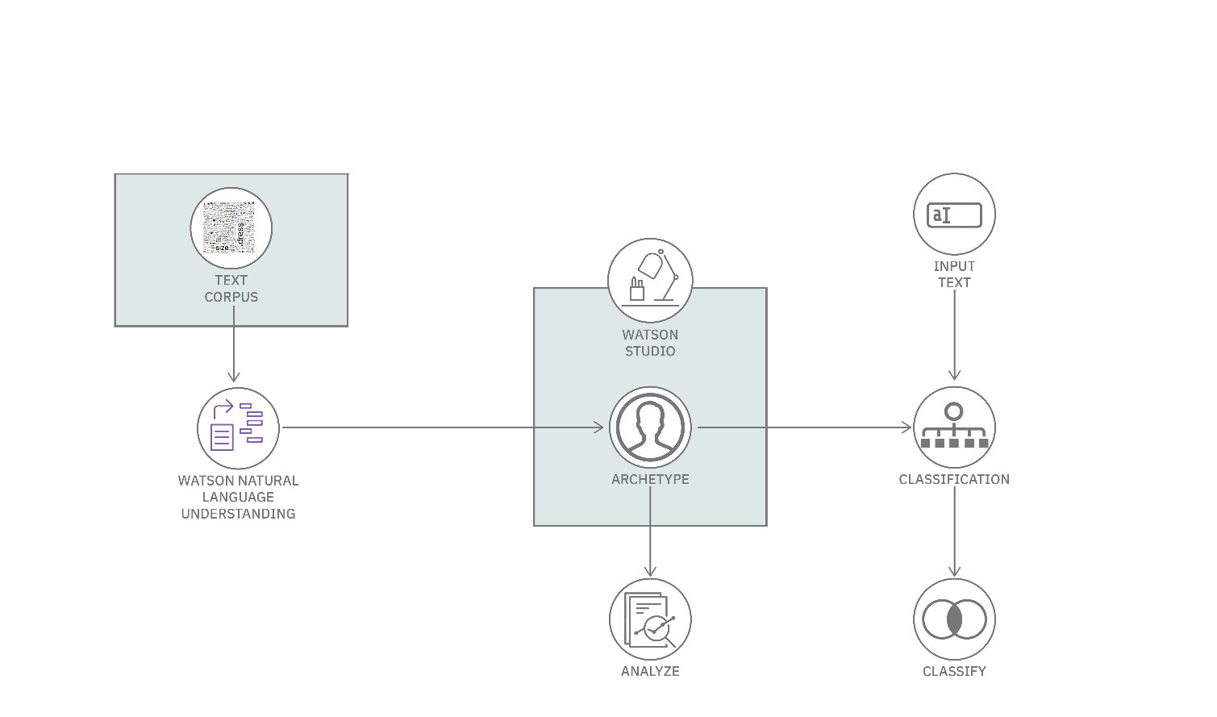
WORKING

Slide 10
SENTIMENT ANALYSER
Conversation analysis aims to determine how participants in a natural conversation understand and respond to one another when it is their turn to talk.
Sentiment analysis is the text analysis to systematically identify, extract, quantify, and study affective states and subjective information. That is, using a powerful analytic tool, we determine if the sentiment of the conversation is either positive, negative, or neutral.

Slide 11
EMOTIONAL ANALYSER
Understanding people’s emotions are essential since people can express their thoughts and feelings, which is a wider classification of the sentiment.
The conversation is analysed and will give the percentage of each emotion in the conversation.
We considered five different emotions and classified performed analysis accordingly, which are joy, sadness, anger, fear, and disgust.

Slide 12
ASPECT ANALYSER
Our final analysis is based on aspects. The task is to classify the sentiment of potentially long texts for several aspects. We have aspects classifications done based on six primary aspects-
Business
Family
Health and Fitness
Disease
Government
Society

Slide 13
SEMANTIC ANALYSER
Latent Dirichlet Allocation (LDA) is used for topic modelling, the process of identifying topics in a set of documents.
In our project, LDA groups the tokenized words from the conversation that fall under a similar topic based on a similarity value.
Thus, we get words related to sexual context under the same topic.

Slide 14
GROOMING DETECTION
A dictionary consisting of the words from the LIWC 2007 dictionary, common slang words used on social media platforms and sexual and abusive words were collected and split across the six grooming stages.
The words in each line of the conversation were assigned a stage and the highest stage was recorded for the corresponding lines. The count of these six stages (S1- S6) are given as input to the classifier.
A Support Vector Machine (SVM) was used to classify the conversation as grooming or non- grooming based on the features determined by the LIWC process.

Slide 15
REPORT PORTAL
In order to widen the scope of this app, the users can also voluntarily report incidents of abusive or offensive chats.
They will have to provide few such instances along with the correspondent’s number.
The report will be forwarded to the concerned authorities and they will get in touch with the reporter.
None of the reports are stored in the application. They are directly mailed to the concerned authorities.

Slide 16
STATISTICS
Statistics provide current number statistics and reported articles on women and child harassment.
In our project, we perform news scraping from the UN Women website to provide the latest articles.
It uses the BeautifulSoup, nltk and newspaper packages to perform news scraping.
It collects the articles from the website and gives the article title and summary.

Slide 17
OUTPUT

Slide 18
RESULTS
The SVM used to identify grooming characteristics gave an accuracy of 91%.
Kernel | Precision | Recall | F1 score | Accuracy
Linear | 0.90 | 0.90 | 0.90 | 0.88
Polynomial | 0.71 | 1.00 | 0.83 | 0.76
RBF | 0.90 | 0.95 | 0.93 | 0.91

Slide 19
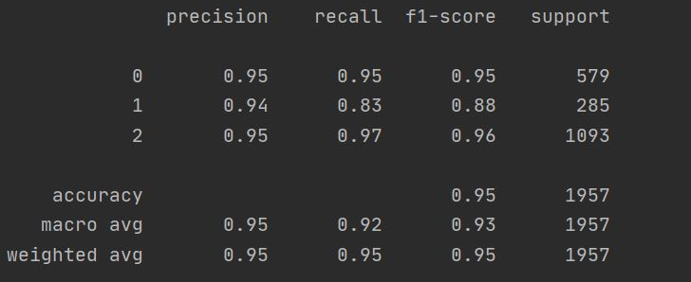
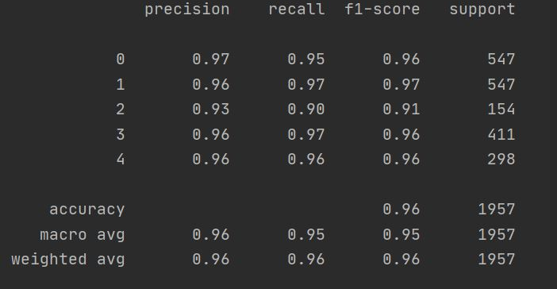
The sentiment analysis tool from IBM Watson yielded an accuracy of 95%.
The emotions analysis tool from IBM Watson yielded an accuracy of 96%.

